Slide 1
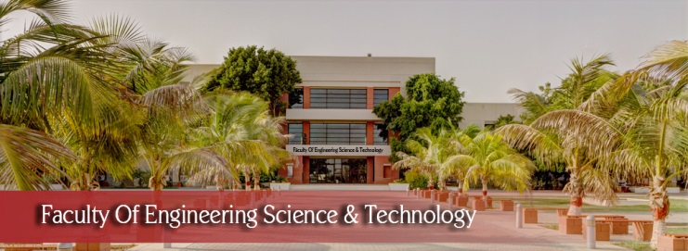

FYP
Dr Crop Android App
Muhammad Ibrahim(1895-2021)
Zeeshan Ali (1505-2021)
Wali Muhammad (1894-2021)
Supervisor: Mr. Saifullah Adnan
Department of Computing, FEST
Hamdard University

Slide 2
Summary
Problem Statement
Objective
FYP Scope
Our methodology
Our Project Plan (Time lines)
Project WBS
Budget / Costing (if any)
FYP Deliverables
References
Item in red color are fundamental in any proposal

Slide 3
Problem Statement
Lack of early detection leads to reduced crop yield
Farmers don’t have access to expert advice in rural areas
Existing tools are not offline or user-friendly

Slide 4
Objective
Train and test a CNN model for wheat diseases
Convert it to TensorFlow Lite
Build a prototype Android app
Evaluate accuracy and usability for future crop support

Slide 5
FYP Scope
This prototype will classify wheat leaf images into four categories: Black Rust, Brown Rust, Yellow Rust, or Healthy. Future iterations will expand the model to include cotton diseases.

Slide 6
Our Methodology
Data collection (Kaggle)
Preprocessing
CNN model training
Conversion to .tflite
Android app integration

Slide 7
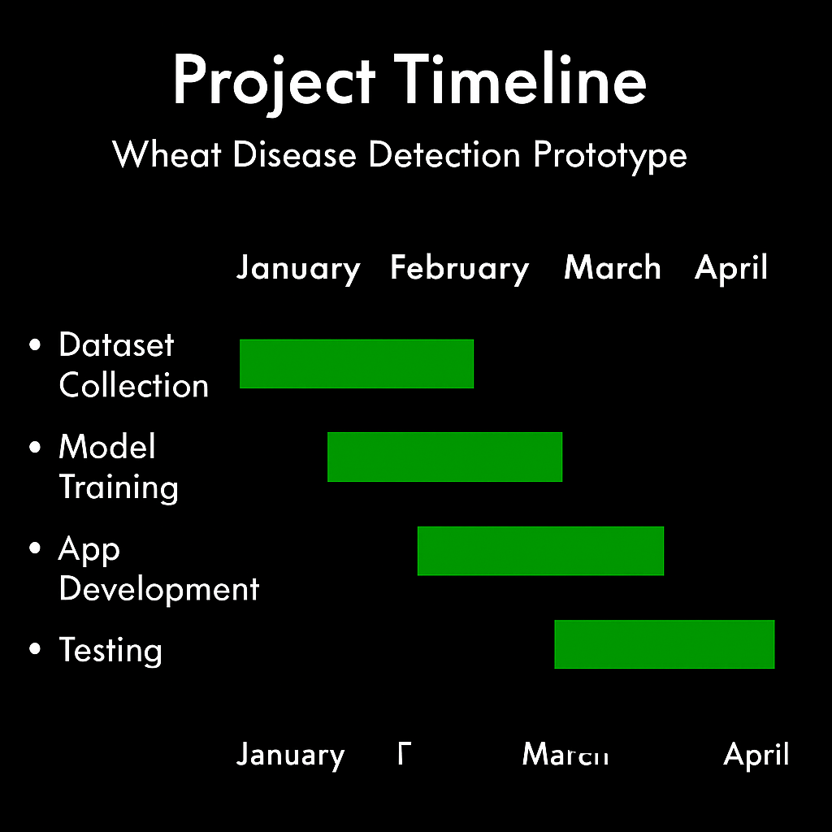
Our Project Plan

Slide 8
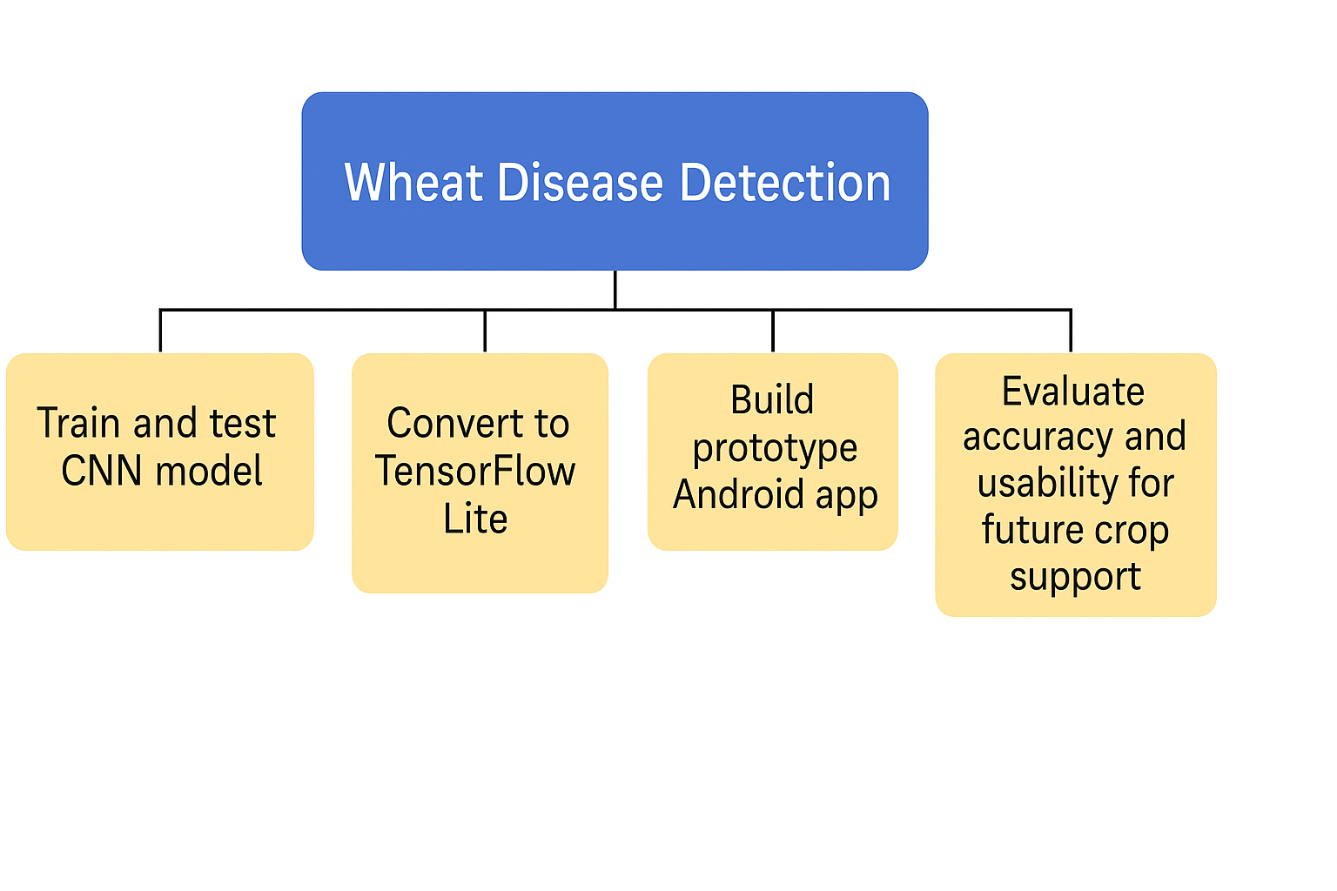
Project WBS

Slide 9
Budget / Costing
No hardware used; software tools were open source (TensorFlow, Android Studio)
Costs: ₹0

Slide 10
FYP Deliverables
Trained model (.h5 and .tflite)
Android prototype app
Report (SRS, SDS, Final Report)
PPT Presentation
Diagrams (UML, ERD, State, Sequence, DFD, WBS)

Slide 11
Reference
TensorFlow Lite documentation: https://www.tensorflow.org/lite
Wheat Disease datasets (custom/collected from Kaggle)
Research papers on CNN for plant disease detection
Android Developer Documentation: https://developer.android.com
Agricultural datasets from open repositories (e.g., Kaggle)

Slide 12
Thank You

